Slide 1
PROJECT- FRAUDULENT TRANSACTIONS
Aiming at detecting fraud transactions and helps to create machine learning model to predict fraud.
Project: P129
Team Name: Group-1
Presenter: Mr. Rahul Kumar Singh
Mentor : Ritesh Maury
Date:

Slide 2
TABLE OF CONTENTS
Fraudulent & Business Understanding
Data Processing
Deployment
Exploratory Data Analysis, Feature Selection, Data Splitting
Finalizing Model Choice, Model performance, Feature importance
The Data Business Objective
- 02 -
- 04 -
- 06 -
- 01 -
- 03 -
- 05 -
Data Understanding
Modeling
Conclusion & Recommendation
Import Libraries Load Data Statistical summaries and visualizations
Technique with Standard Scaler, Handling Imbalance Dataset, Machine Learning Algorithms

Slide 3
Project Workflow & Strategy
Data Processing
Data Understanding
What are the customer under different transaction type and the number of times they occurred group with Fraud data?
We will also check the same for the flagged fraud data.
We will plot data distribution on different numerical features.
What is the percentage of fraud & Flagged Fraud? With Pie chart.
What is the total transaction under different type? With Pie and Bar chart.
Sunburst chart on amount under different transaction type and whether it is fraud or not same for Flagged fraud.
Most common amount transferred regularly.
Min Max Under oldbalanceOrg Features, Amount When Fraud Is True & Flagged Is True
Feature Extraction on step, old balance – new balance of sender and receiver. And lastly feature importance
What are the data types of the column?
Statistical summaries of the dataset.
What is the total transaction?
Is the dataset consist of null values? Heatmap to see the null values.
Correlation between the features? And duplicate records in the dataset.
Lastly, we will do pandas profiling to check more on data with details.
01
02
03
04
Data Modeling
On what features to be used for splitting the dataset?
Handling imbalanced dataset. Scaling the dataset.
What type of machine learning model should be used and why we will use that model?
What type of accuracy to be used to see model performance.
Which model to finalize and why?
Deployment & Conclusion
We will use streamlit for model deployment.
Discuss on various features and how to minimize the fraud.

Slide 4
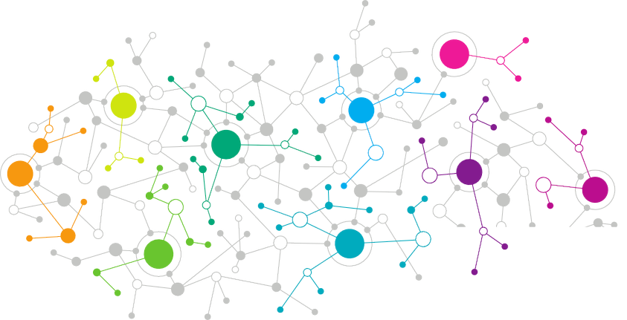

Fraudulent Transaction & Business Understanding
01

Slide 5
What is Payment Fraud?
RAUDULENT
F
Payment fraud is any type of false or illegal transaction completed by a cybercriminal. The perpetrator deprives the victim of funds, personal property, interest, or sensitive information via the Internet.
Ecommerce businesses rely on electronic transactions to charge customers for products and services. The increased volume of electronic transactions has also resulted in an increase in fraudulent activities.
Transactions &
Business Understanding
Types of fraud:-
Business credit card fraud
Wire fraud
ACH fraud
Forgery
Invoice fraud
Phishing
Identity theft
Pagejacking
Merchant identity fraud
How can e-commerce businesses mitigate fraud?
While it's challenging to entirely eliminate the threat of fraud for eCommerce stores, you can help protect against it by continually updating your network security systems.
There are a number of other ways to protect your business against fraudulent payments:
Maintain awareness of the latest fraud trends
Partner with a verified payment processor
Encrypt transactions and emails containing confidential information
Ensure that tokens and login credentials are regularly changed
Establish a policy regarding access to confidential information
Constantly run security checks with antivirus software
Require customers to log in to an individual account prior to making a purchase
How does fraud happen?
Hackers often pose as a legitimate representative and contact credit card owners asking for sensitive information, then use the following means of interaction to steal personal data:
Email
Texting malware to smartphones
Instant messaging
Rerouting traffic to fraudulent websites
Phone calls
Online auctions

Slide 6
F
RAUDULENT
What is fraudulent transactions?
Transactions &
Business Understanding (Cont’d)
A fraudulent transaction is the unauthorized use of an individual’s accounts or payment information. Fraudulent transactions can result in the victim’s loss of funds, personal property, or personal information.
The fraudulent transaction is one of the most serious threats to online security nowadays. Artificial Intelligence is vital for financial risk control in the cloud environment. Many studies attempted to explore methods for online transaction fraud detection; however, the existing methods are insufficient to conduct detection with high precision.
Fraud prevention is the implementation of a strategy to detect fraudulent transactions or banking actions and prevent these actions from causing financial damage and the reputation of the client and the financial institution.
There are always financial frauds and They can happen in virtual and physical ways. So the investment in security has been increasing.
Keep your business safe from online payment fraud
There is no guaranteed method for payment fraud prevention. By taking certain precautions, however, you can minimize the damage they cause and make sure your business has the best chance to thrive despite them.

Slide 7
Business Understanding
BUSINESS PROBLEM- FRAUD TRANSACTIONS CLASSIFICATION
We will build a classifier for predicting fraud transactions.
Business Objective
Business Objective
objective: To develop a model to predict whether a transaction is fraudulent or not. To predict feature importance which can help in predicting fraud more easily. Our main goal is to minimize the fraud and derive the best accuracy model with less log loss value.

Slide 8
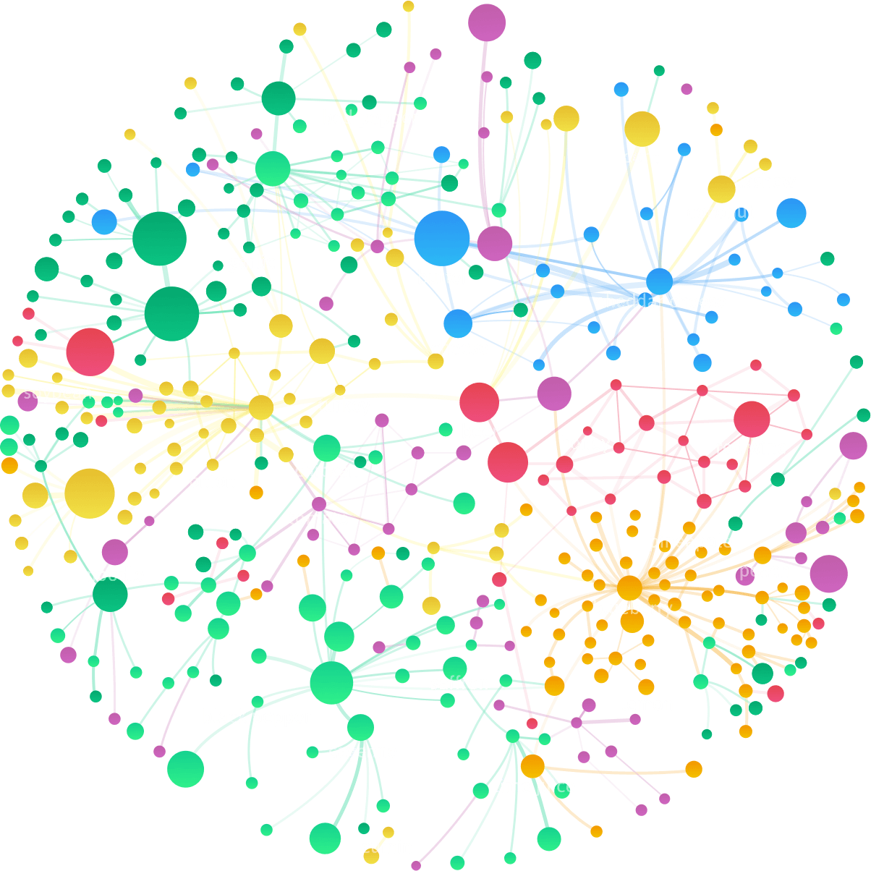

02
DATA
UNDERSTANDING

Slide 9
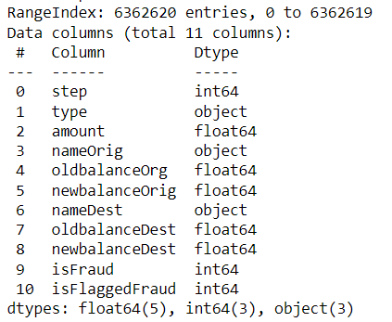
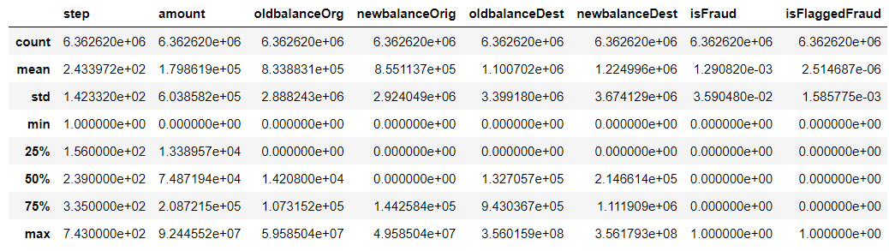
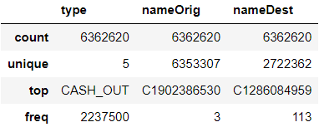
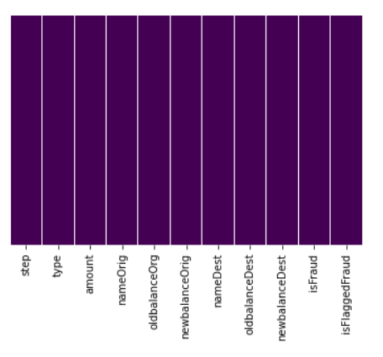
DATA UNDERSTANDING
Inference:
- We can see of the data types of the columns.
- In categorical columns 'type' dtypes are objects we have to convert numerical.
- The 'isfraud' column has been identified as incorrect data type i.e. integer. But it should be boolean instead. Same is the case for 'isflagged'.
Inference:
The records are very large for description.
25% of the data is zero oldbalanceOrg, newbalanceOrig, oldbalanceDest & newbalanceDest.
50% of the data is zero under newbalanceOrig. That means mabybe sender account goes nil by any means of fraud.
There is an average transaction amount of 1.798619e+05, which is been moving in the system from sender to receiver.
75% of transaction have happened with amount <= 2.087215e+05.
On an average, the sender maintains a balance of 8.338831e+05 and this can be the case targeted by the fraudster.
The average transaction which is predicted under fraud is 1.290820e-03. And for Flagged Fraud is 2.514687e-06.
On an average step is 2.433972e+02 (unit of time).
There are 5 category under type columns and among them mostly used by customer is CASH_OUT and the freq of occurence is 2237500 which is quite large.
In the nameOrig the customer maximum transaction is 3 which is quite normal.
In the nameDest the customer which is receiving maximum frequency is 113 which is not normal as it is a customer account. So we have to check for these type of customer they come under the consideration of fraud.
From the left heatmap there are no null values inside the dataset.

Slide 10
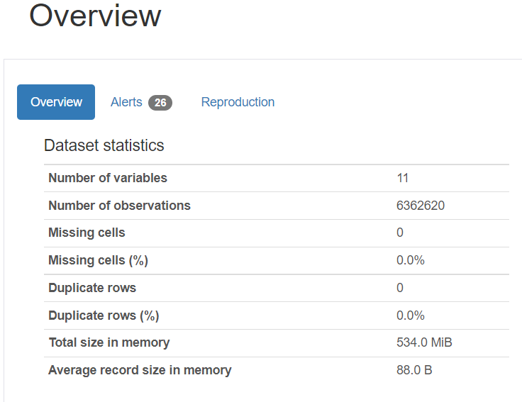
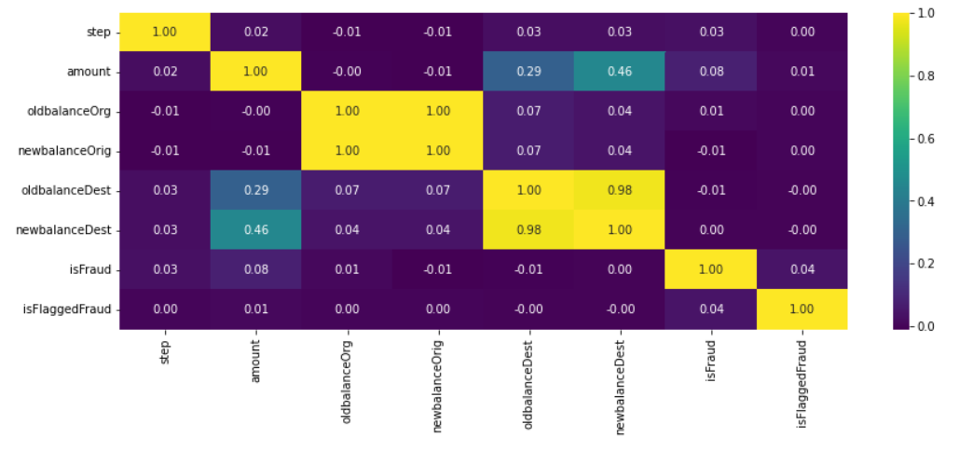
DATA UNDERSTANDING
Inference: Pandas Profiling Report
Profiling Report (Open file name: Fraud_transaction Profiling Report.html)
There are no missing cells in the dataset.
There are no duplicate rows.
There are 6 numerical and 5 categorical variable types.
NameOrig has a high cardinality: 6353307 distinct values. nameDest has a high cardinality: 2722362 distinct values.
oldbalanceDest, newbalanceDest is highly correlated with amount.
oldbalanceOrg is highly correlated with newbalanceOrig
oldbalanceDest is highly correlated with newbalanceDest
Type is highly correlated with newbalanceOrig
amount is highly skewed (γ1 = 30.99394948)
nameOrig is uniformly distributed
oldbalanceOrg has 2102449 (33.0%) zeros
newbalanceOrig has 3609566 (56.7%) zeros
oldbalanceDest has 2704388 (42.5%) zeros
newbalanceDest has 2439433 (38.3%) zeros
Fraud Transaction are 8213 which is very less with respect to the dataset.
Flagged Fraud Transaction are only 16 which is very less with respect to the dataset.
Inference:
We can see only oldbalanceDest and newbalanceDest have strong linear relationship. oldbalanceOrg and newbalanceOrig also have stron relationship.
newbalanceOrig, oldbalanceDest are both negatively correlated with isFraud.
oldbalanceOrg, newbalanceOrig have negative correlation with amount.
isFlaggedFraud, step, isFraud are uniformly distributed and there is no correlation with other variable. This can all be because dataset is imbalanced.

Slide 11


03
DATA
PROCESSING

Slide 12
F
EATURE
ENGINEERING
ON DIFFERENT
Types Of Transactions

Slide 13
Feature Engineering
As from the dataset we are not fully satisfied with the isFraud column as it is correct or not. So, we will do Feature Analysis on it. We will make a new column with the name 'Fraud_Check' where we will clearly classify fraud/Not Fraud data. We will check the dataset with 6 conditions to verify whether the transactions isfraud or not. We will remove rows after every condition gets true to get a better view of the left transaction in the dataset.
Fraud Can happen mostly on financial transactions from your account and without your knowledge. It occurs when a criminal gains access to your card number—and in some cases, personal identification number (PIN)—to make unauthorized purchases or withdraw cash from your account. So, these type of transactions can only happen under TRANSFER and CASH OUT.
CASH OUT
TRANSFER
PAYMENT
CASH IN
DEBIT
Fraudulent cash-out refers to the withdrawal of cash from a card through a fake purchase transaction that bypasses the interest charges and credit limits of cash advances set by the issuing bank. CASH OUT only deals with origin account. It helps the fraudster to cash out the money, they always try to drain out the account balance. we will take these transactions as fraud because they are draining the origin account balance and cashing out from the system. Same amount is being transfer and cash out.
In a money transfer fraud, the fraudster will approach you via email, call, WhatsApp or SMS and will lure you to access malicious links for making payments. These fake bank URLs will look almost identical to the original URL which makes it difficult to identify in first glance if you are not careful. An authorized push payment (APP) scam, also known as a bank transfer scam, occurs when you - knowingly or unwittingly - transfer money from your own bank account to one belonging to a scammer. Here also scammer transfer the amount and cash out.
Payment is like when we pay to any merchant or to any customer by way of digital transactions like UPI. In our dataset we have been given Payment details of only merchants and they are not provide with any account balance details. So, without knowing the balance details we are not sure that the transactions is Fraud or not. So, we will just drop these transactions as they are no use to us for modeling.
It happen when cash is deposited to someones account and his account balance gets increase. CASH IN affect only the origin account and not the destination account if that happen than those transaction will be termed as transfer not cash in. CASH IN only deals with origin account as it affect only the amount of origin account. It increases the balance at origin account. The bank do not consider CASH IN as a fraud because it is fully under the conscience of the customer and not the bank. And we are also not given with any details on how to set fraud, so we will just use the bank domain knowledge and will drop these type of transactions.
A bank debit occurs when a bank customer uses the funds in their account, therefore reducing their account balance. Bank debits can be the result of checque payments, honored drafts, the withdrawal of funds from an account at a bank branch or via ATM, or the use of a debit card for merchant payments. So, withdraw of funds here is separated with CASH OUT, merchant payments is separated as PAYMENT. We are left with cheque payments and honored drafts, these both transactions are under the will of customer. Debit here only affect the origin account. Bank deals with these transaction as under the conscience of the sender. So, we can also drop these transactions as they cannot leads to Fraud.

Slide 14
Feature Extraction Condition
Condition 1
Condition 2
Condition 3
In this will check the acccount with nill balance in Origin account and Destination account. We will remove these transactions as they are not fraud. No balance in Origin account leads to no transaction.
First we will replace all Origin account where the old balance and new bal is zero and amt is not equal to zero with NaN. As these transactions are not fraud as the origin account do not have balance. We will remove these transactions. We will also check destination account where old balance and new balance is zero but amount is not equal to zero with -1. As these account Face true Fraud. Here Amount is transferred but not received or not affected the destination account. We will check these transactions step by step.
Removing Payment type of transactions as it consists only merchants account and we do not have any balance detail. So, we will consierd these balance as not Fraud and will remove them from the copied dataset. We will also remove DEBIT & CASH IN transactions as bank do not considered it as a fraud and they are under the will of the customer.
Condition 4
Condition 5
Condition 6
Here we will take both transfer and cash out type of transaction as one dataframe as they both are related to each other. A fraudster use this technique where they drain the origin customer account transfer it and cash out from the system. We will keep these transaction seprately and remove it from combined dataframe.
From, the left dataframe we will filter for TRANSFER type of transactions and than we will consider those transactions which amount is equal to difference in balance origin and difference in destination balance is zero. That means those amount which are debited from origin account but have not been affected in the destination account. Those transaction will be considered as fraud.
From the transfer and cash out left dataframe we will remove those transactions were old balance orig is less than amount as those are considered as not fraud because origin account balance is less not able to transfer the amount rest we will check for fraud.

Slide 15
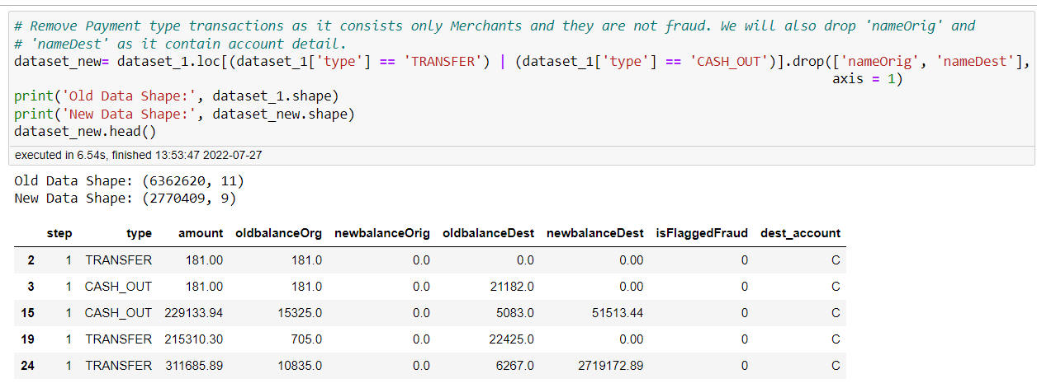
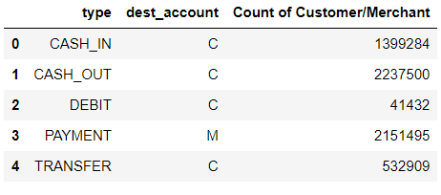
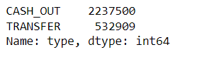
Feature Extraction Condition 1
Removing Payment type of transactions as it consists only merchants account and we do not have any balance detail. So, we will consierd these balance as not Fraud and will remove them from the copied dataset. We will also remove DEBIT & CASH IN transactions as bank do not considered it as a fraud and they are under the will of the customer.
Inference:
Only PAYMENT consists of the receiver is Merchant. And the count of transaction is quite large 2151495. We are also not given merchant account balance details. If the balance of merchant were given than we can check for fraud.
From above we can see only PAYMENT consists Merchant account.
Inference:
Removing these transactions leads our dataset getting less which will help us to find fraud more easily & fast.
Remove Payment as it consists only Merchant and we do not have any balance details. So, we will considerd these balance as not fraud and will remove them from dataset.
Remove Payment type transactions as it consists only Merchants and they are not fraud.
We will also drop 'nameOrig' and 'nameDest' as it contain account number details.
We will also remove CASH IN as it only deals with origin account as it affect only the amount of origin account. It increases the balance at origin account. The bank do not consider CASH IN as a fraud because it is fully under the conscience of the customer and not the bank.
As per discussion above we will also remove DEBIT. As bank debit occurs when a bank customer uses the funds in their account. Bank debits can be the result of cheque payments, honored drafts. Debit here only affect the origin account. Bank deals with these transaction as under the conscience of the sender. So, we can also drop these transactions as they cannot leads to Fraud and they are under the conscience of the customer.

Slide 16
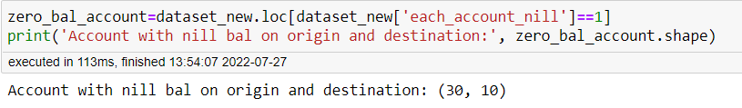
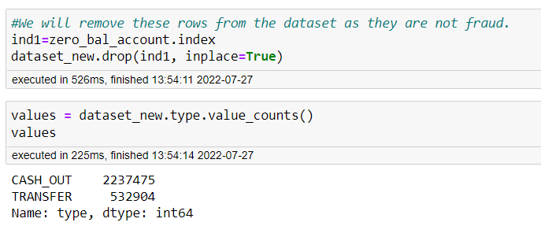
Feature Extraction Condition 2
Account with nill balance in origin and destination. We will remove these transactions as not fraud. No balance in origin leads to no transactions in destinations.
Inference:
Transactions with nill balance in origin and destination have been removed as those are not fraud. No balance in origin leads to no transactions in destinations.

Slide 17
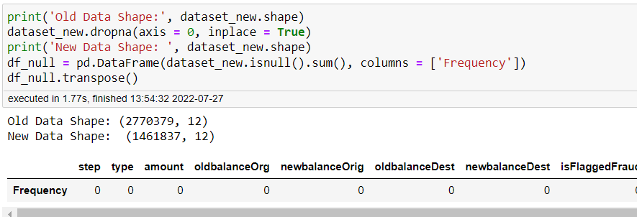
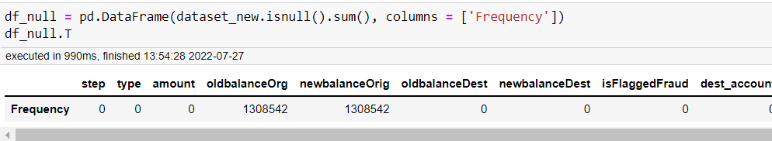
Feature Extraction Condition 3
First we will replace all Origin account where the old balance and new bal is zero and amt is not equal to zero with NaN. As these transactions are not fraud as the origin account do not have balance. We will remove these transactions. We will also check destination account where old balance and new balance is zero but amount is not equal to zero with -1. As these account Face true Fraud. Here Amount is transferred but not received or not affected the destination account. We will check these transactions step by step.
Inference:
Replacing1 - In first replacing we have checked that if old balance origin is zero and new balance origin is zero and amount is not equal to zero, at that case these transactions are considered not fraud as the origin account do not consists any balance so no transactions will happen. We will remove these transactions.
Replacing2 - Here, we have checked that if old balance of destination is zero and new balance of destination is zero and amount is not equal to zero at that case these transactions are considered as fraud because amount transferred not received or not affected in the destination account.

Slide 18
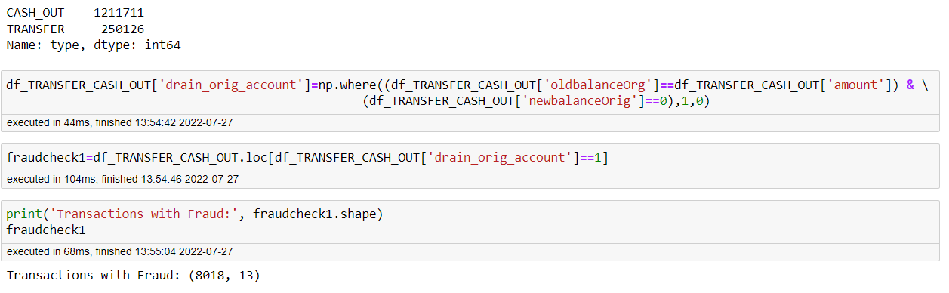
Feature Extraction Condition 4
Here we will take both transfer and cash out type of transaction as one dataframe as they both are related to each other. A fraudster use this technique where they drain the origin customer account transfer it and cash out from the system. We will keep these transaction seprately and remove it from combined dataframe.
Here we will take both transfer and cash out type of transaction as one dataframe as they both are related to each other. A fraudster use this technique where they drain the origin customer account transfer it and cash out from the system
While looking at the dataframe above you will notice that amount is first Transfer and then Cash Out. These transactions are considered as Fraud.
So, we will create a column where drain of origin account is seen.
Inference:
So, we will take these transactions as fraud because they are draining the origin account balance and cashing out from the system. Same amount is being transfer and cash out.

Slide 19
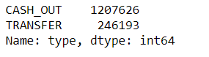
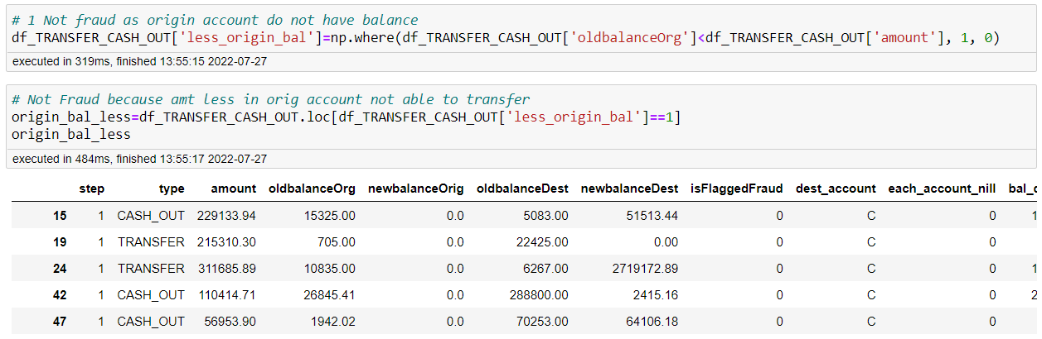
Feature Extraction Condition 5
From the transfer and cash out left dataframe we will remove those transactions were old balance orig is less than amount as those are considered as not fraud because origin account balance is less not able to transfer the amount rest we will check for fraud.
Now, we will remove those transactions where old balance origin is less than amount as those are considered as not fraud because origin account balance is less not able to transfer the amount. Rest we will check for fraud.
Inference:
Here, we have removed those transactions where old balance origin is less than amount as those are considered as not fraud because origin account balance is less not able to transfer the amount.

Slide 20
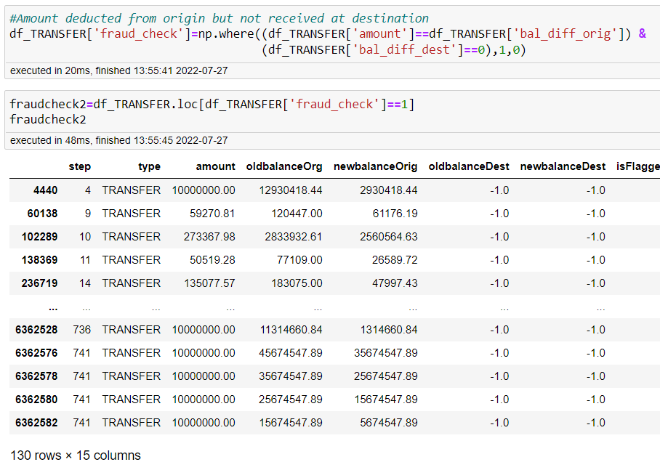
Feature Extraction Condition 6
From, the left dataframe we will filter for TRANSFER type of transactions and than we will consider those transactions which amount is equal to difference in balance origin and difference in destination balance is zero. That means those amount which are debited from origin account but have not been affected in the destination account. Those transaction will be considered as fraud.
Now we will take only TRANSFER transactions.
We will check transactions whose amount is debited but not transfer to destination account.
Inference:
Here we are considering those amounts which are equal to difference in balance of origin but those have not been affected in the destination account. Those transactions will be considered as fraud.

Slide 21
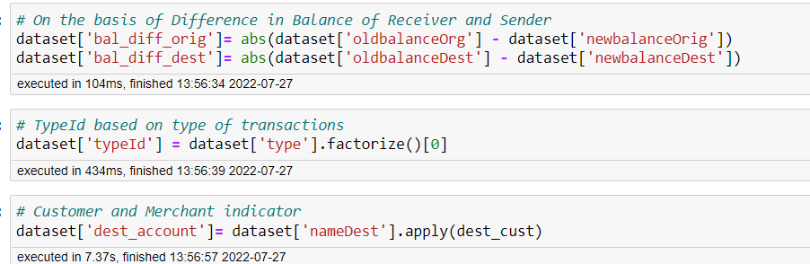
Feature Engineering On Other Aspects
With the available information it is hard to train the model and get better results. Hence we move onto create new features by altering the existing features.
Difference in balance: It is an universal truth that the amount debited from senders account gets credited into the receivers account without any deviation in cents. But what if there is a deviation incase of the amount debited and credited. Some could be due to the charges levied by the service providers, yet we need to flag such unusual instances
Merchant indicator: The customer ids in receiver starts with 'M' which means that they are merchants and they obviously will have a lot of receiving transactions. So we also flag whenever there is a merchant receiver.
Type indicator: Type id based on transaction type.
These new features turn out to be important in obtaining the best performance from the ML algorithm that we will finally use.

Slide 22
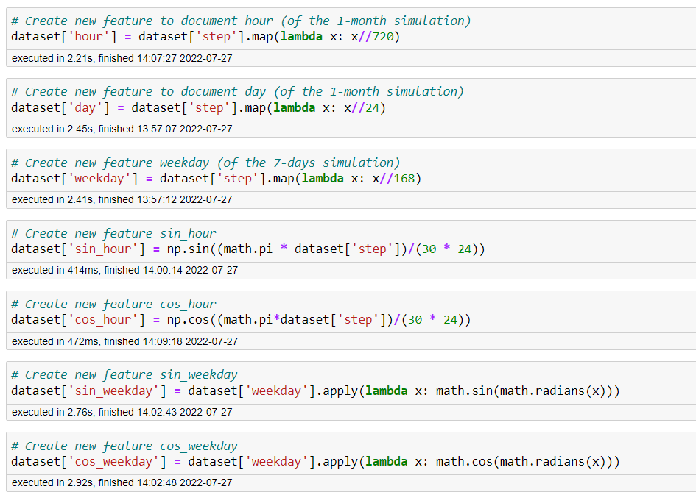
Feature Engineering On Step Variable
Inference:
The dataset spans over one month, with the feature step presenting the number of hours between each transaction and the first transaction in the dataset. It does not reflect directly enough all useful information, and is a good candidate for additional feature engineering. The original feature list is extended with seven features engineered and encoded from the step feature.
There are three directly encoded features:
hour—presenting the number of hours from the referent time point (first transaction) in 24 h time cycle, where feature range is 0–23
day—presenting the day in the month in 30 days month cycle, where the feature range is 1–30
weekday—presenting the day in the week in seven-day week cycle, where the feature range is 1–7
hour and weekday, do not reflect cyclic nature of time. To solve this, four new features are created deriving a sine transform and cosine transform of the respective features—sin_hour, cos_hour, sin_weekday and cos_weekday.

Slide 23
EXPLORATORY DATA ANALYSIS

Slide 24
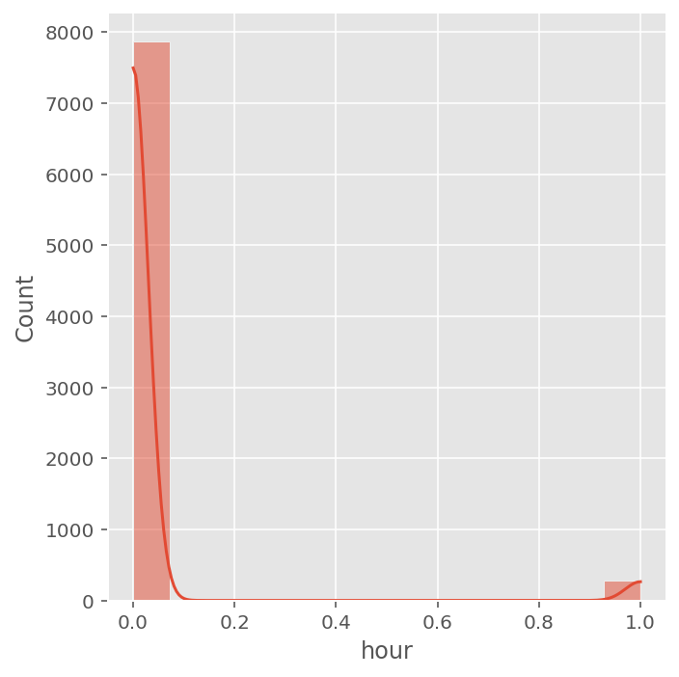
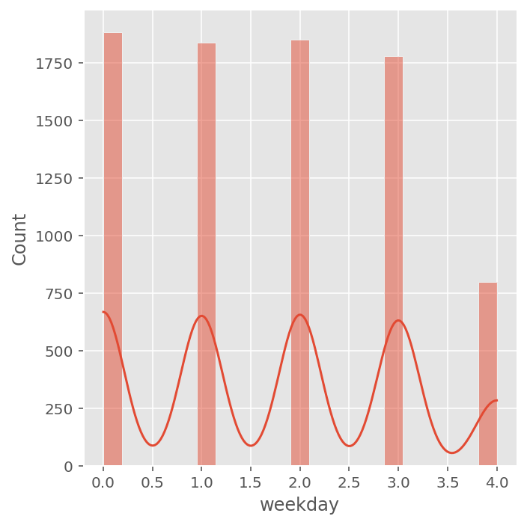
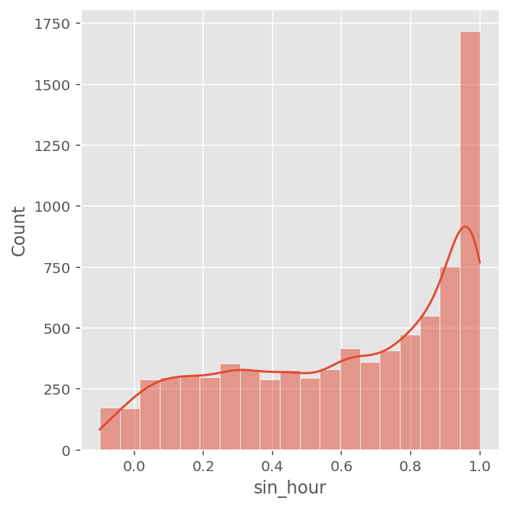
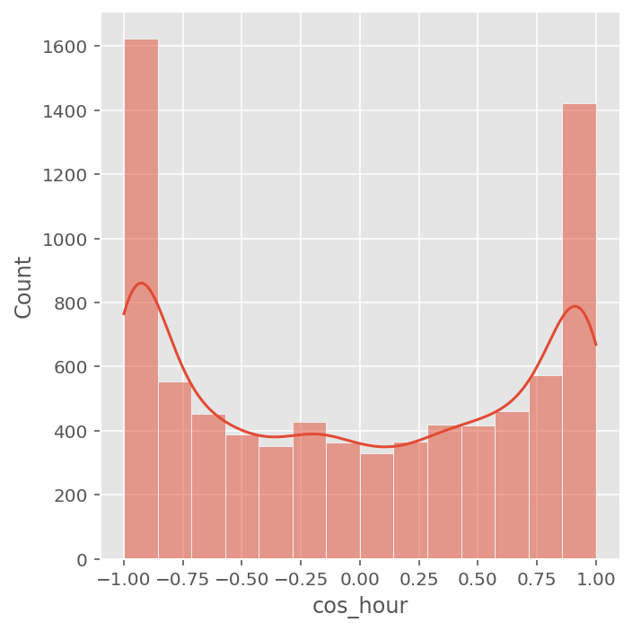
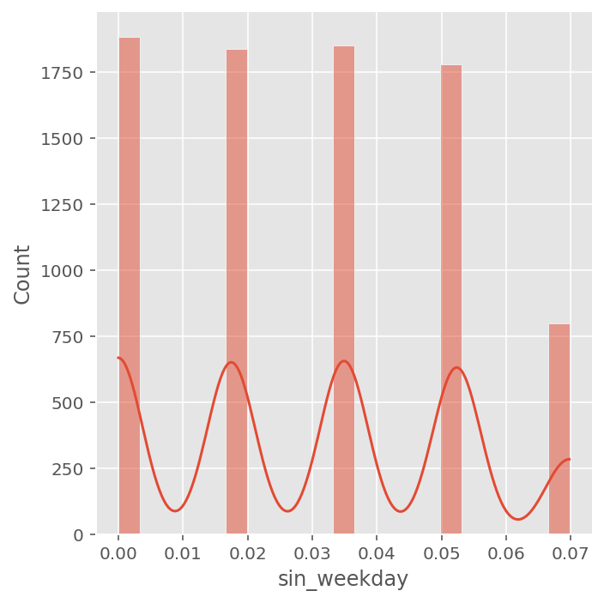
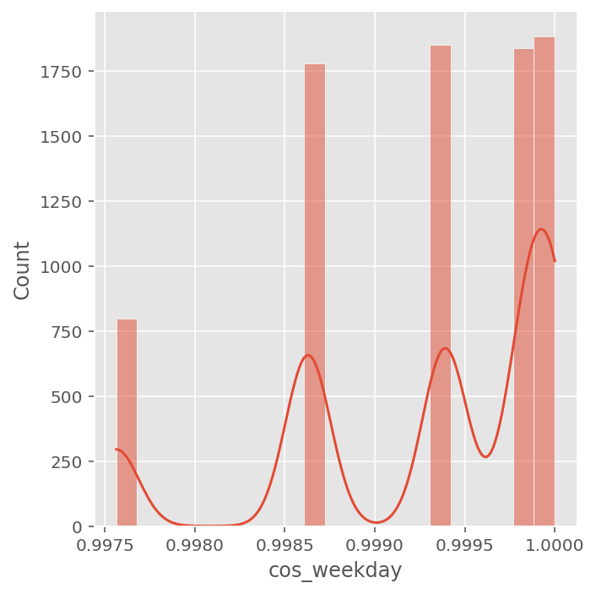
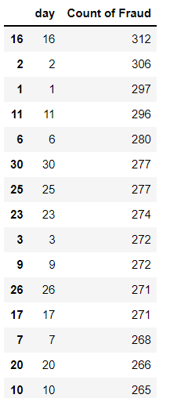
EXPLORATORY DATA ANALYSIS & DATA PREPARATION
01. DISTRIBUTION PLOT ON STEP DATA WITH FRAUD CHECK ID
Inference:
hour and weekday, do not reflect cyclic nature of time
Now, with sin and cos we can get a cyclical nature of time.
The distribution plot of the day is random that is fraud can happen at any time. Although there is a gap of 1 day after every fraud transaction either after 1day or 2day.
On mid of the month there is max fraud.

Slide 25
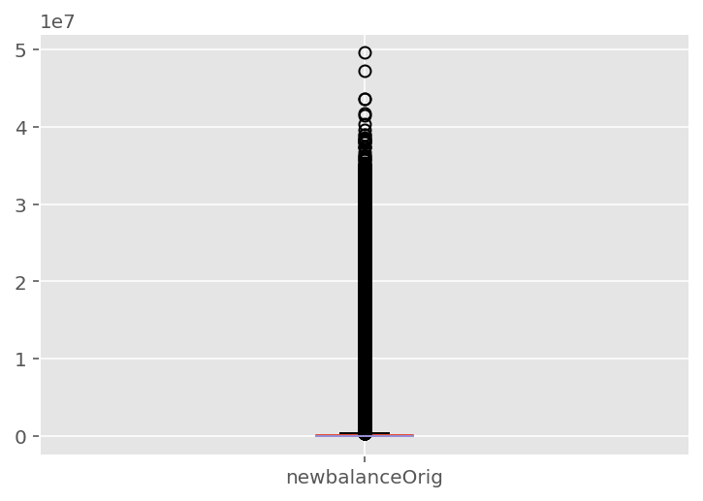
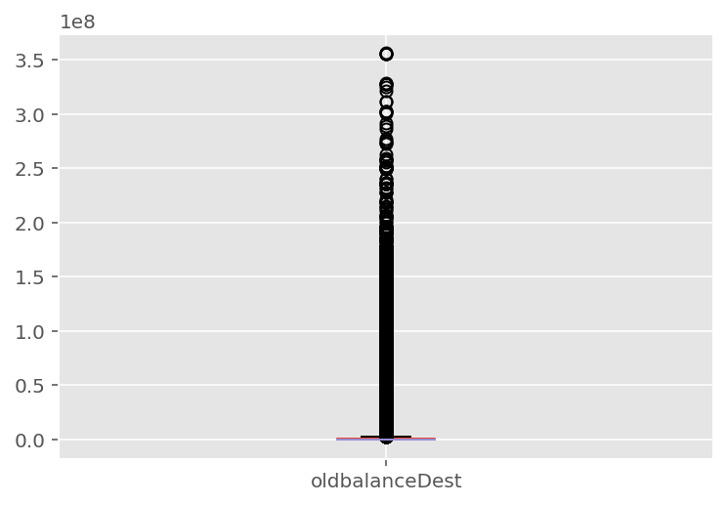
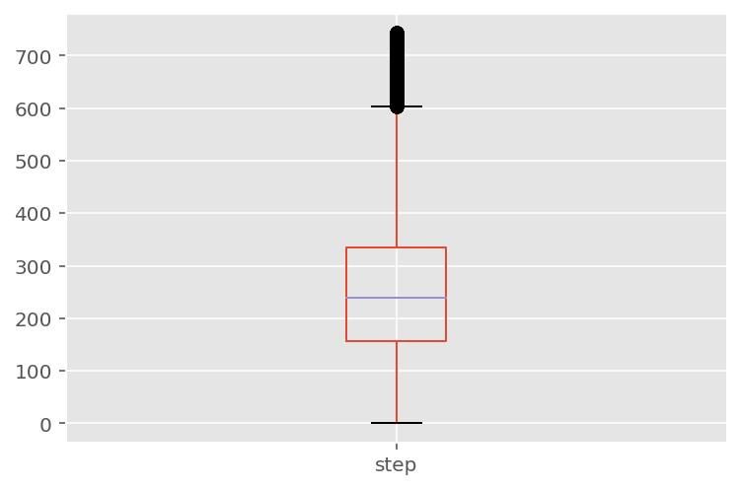
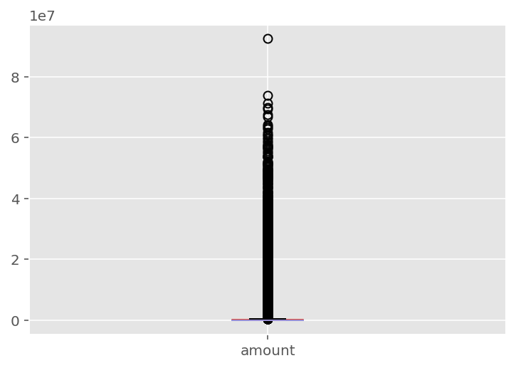
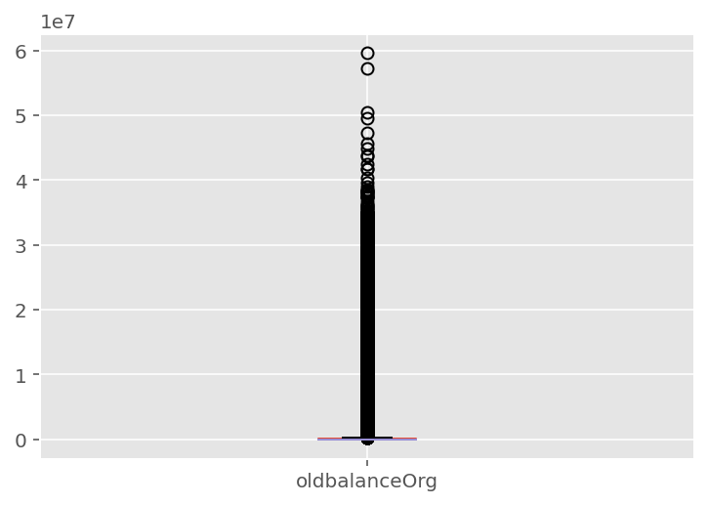
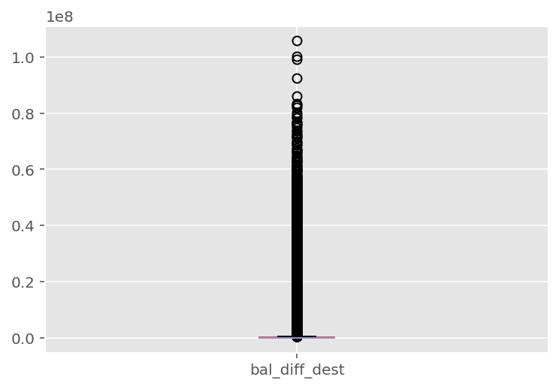
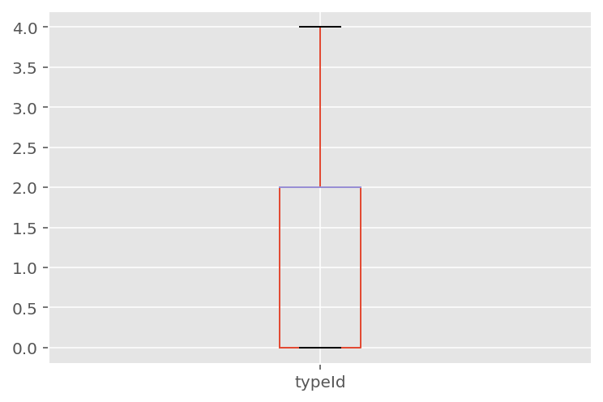
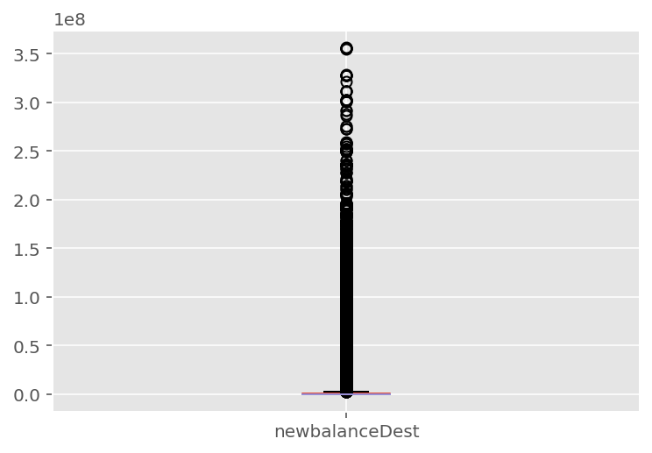
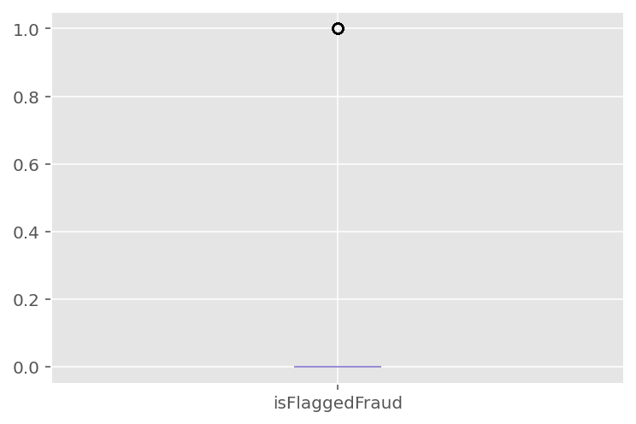
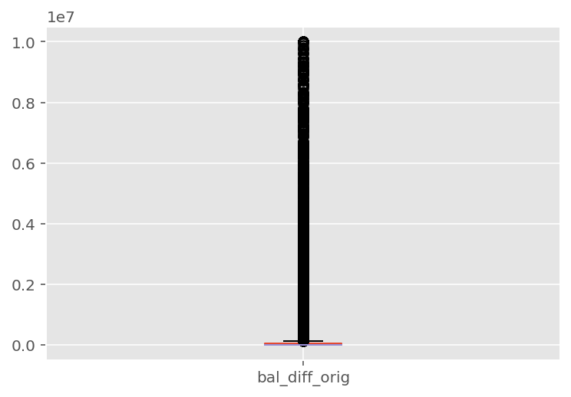
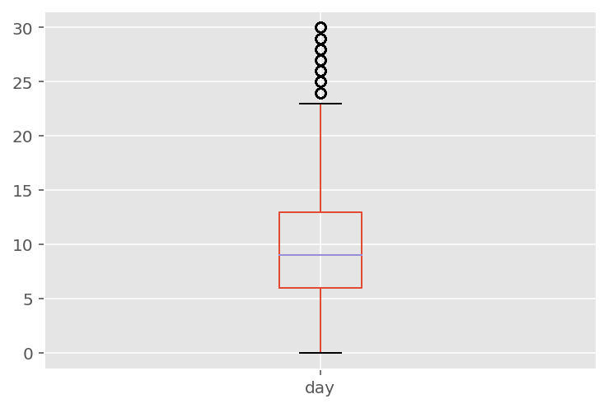
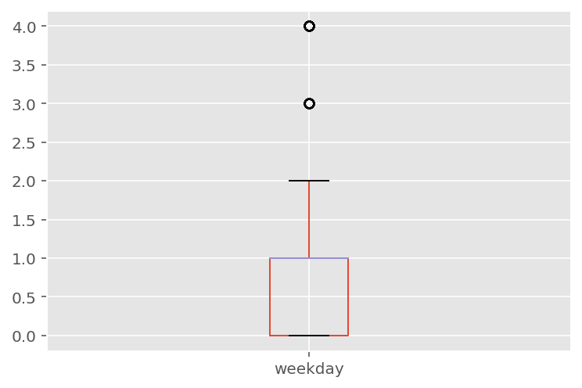
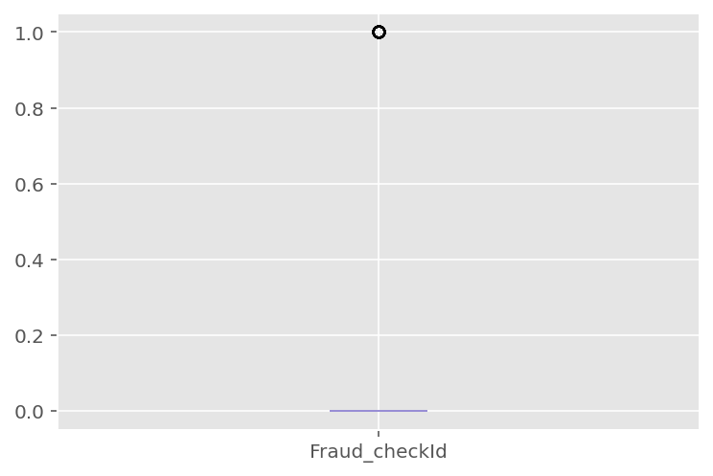
EXPLORATORY DATA ANALYSIS & DATA PREPARATION
02. BOX PLOT FOR NUMERICAL FEATURES
Inference:
The box plots show that the number of outliers for nearly all original dataset features are really high. This indicates that a contamination factor used in the later methods should not be too low.
Based on box plots, it can also be concluded that none of the features is symmetrically distributed, and that the Elliptic Envelope method is not suitable for this dataset.
The box plots show that the number of outliers for nearly all original dataset features are really high.
It can also be concluded that none of the features is symmetrically distributed.
box plots indicate that features amount, oldbalanceOrg, newbalanceOrig, oldbalanceDest and newbalanceDest are highly skewed, and they should be further processed before training machine learning models.

Slide 26
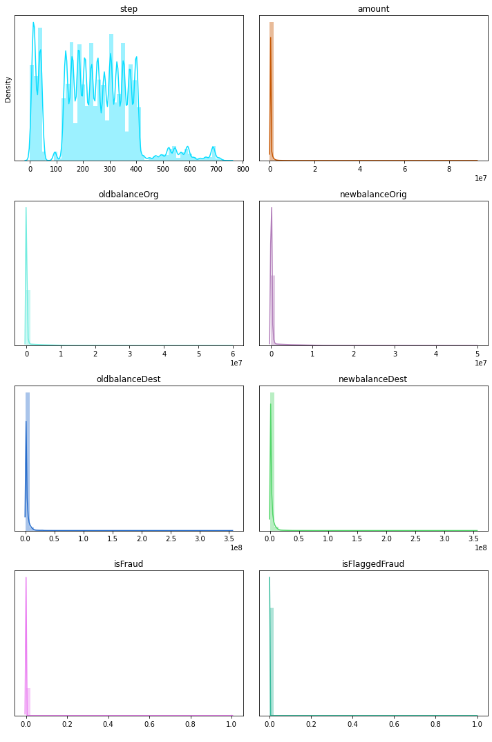
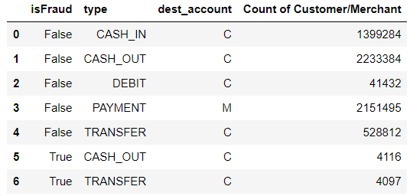
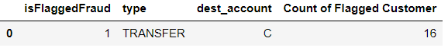
EXPLORATORY DATA ANALYSIS & DATA PREPARATION
01. DATA DISTRIBUTION
02. Checking with the Customer and Merchant who is facing the fraud, and in which category type.
Inference:
Only PAYMENT consists of the receiver is Merchant. And the count of transaction is quite large 2151495. We are also not given merchant account balance details.
The count of transaction under True Fraud and in CASH_OUT & TRANSFER category. This shows mostly customer face the issue of fraud as we dont have any details of merchant customer.
There are only 16 transaction which is considered as True Flagged Fraud Customer and only in TRANSFER category. Here also customer is only facing the issue not merchant.
Inference:
All numerical features are positively skewed except step.
Step feature consists of random data.

Slide 27
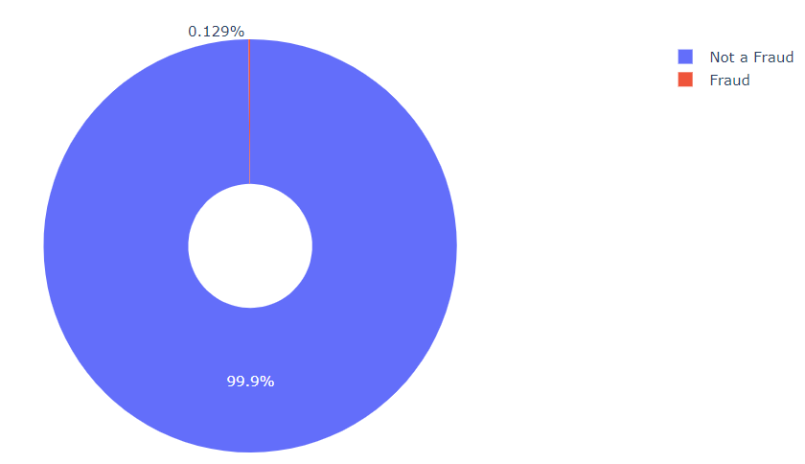
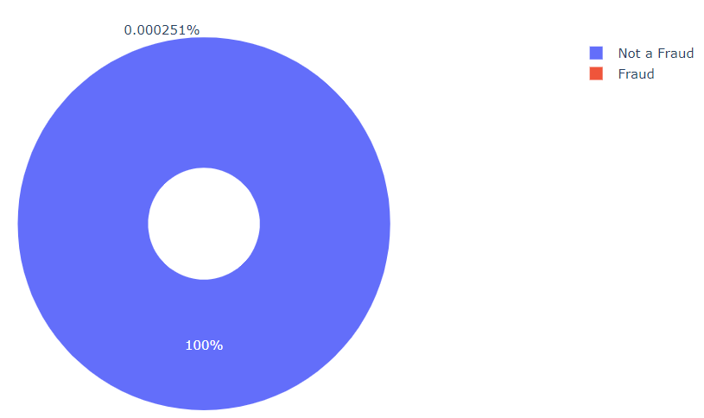
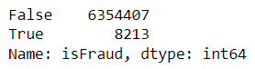
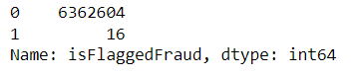
EXPLORATORY DATA ANALYSIS & DATA PREPARATION (Cont’d)
03. Percentage of Fraud Piechart
04. Percentage of Flagged fraud Pie chart
Inference:
From the above donut chart we can see that mostly Not a fraud is 99.9% and only Fraud case is 0.129%.
Inference:
From the above donut chart we can see that mostly Not Flagged fraud is high and there is only 16 transaction under flagged fraud which is very less.

Slide 28
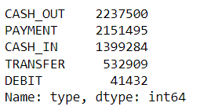
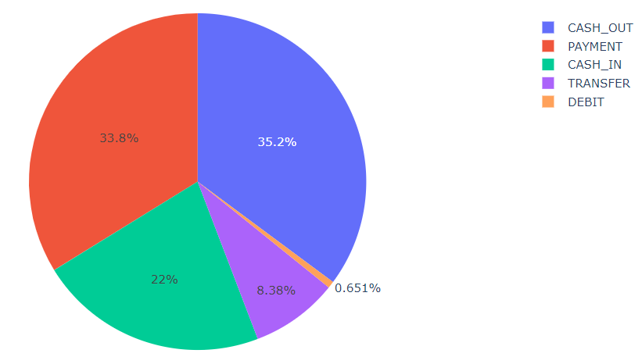

EXPLORATORY DATA ANALYSIS & DATA PREPARATION (Cont’d)
05. Pie Chart & Bar Chart for type transaction
Inference:
We can see that count of CASH_OUT transaction is more than any other type of transaction and that is 35.2% of all the transaction.

Slide 29




EXPLORATORY DATA ANALYSIS & DATA PREPARATION (Cont’d)
06. Sunburst chart on the amount under different transaction types and on fraud feature.
07. Sunburst chart on the amount under different transaction types and on Flagged fraud feature.
Inference:
We can see the average amount transferred under each transaction type and group them on the fraud feature.
Under False Fraud CASH_OUT average amount is showing the highest average.
Under True Fraud TRANSFER average amount is showing the highest average.
From the above sunburst chart, we have compared the isfraud with all type transaction. In the isFraud True we can see that CASH_OUT and TRANSFER are only there.
Inference:
We can see the average amount transferred under each transaction type and group them on flagged fraud.
From the above sunburst chart, we have compared the isFlaggedFraud with all types of transactions. In the isFlaggedFraud True we can see that TRANSFER is only there.

Slide 30



EXPLORATORY DATA ANALYSIS & DATA PREPARATION (Cont’d)
08. Count Of Fraudulent Under each Type
09. Most Common Amount Used for Transaction
Inference:
Bar chart on count of transaction when fraud is True.
CASH_OUT-4116
TRANSFER-4097
Count Fraudulent under each type.
Inference:
In the chart we can see the 20 most common amounts used for transactions.

Slide 31




EXPLORATORY DATA ANALYSIS & DATA PREPARATION (Cont’d)
10. Min Max Under Amount Features When Fraud Is True & Flagged Is True
11. Min Max Under oldbalanceOrg Features When Fraud Is True & Flagged Is True
isFraud
isFlaggedFraud
isFraud
Inference:
Min Max Under Amount Features When Fraud Is True & Flagged Is True
From the above table we can see that Max Amt under Fraud is 10000000.0 for both transaction type(CASH_OUT, TRANSFER).
From the above table we can see that Max Amt under Flagged Fraud is 10000000.0 for transaction type(TRANSFER) and Min Amt is 353874.22.
This shows the average amount fraudster try to swipe out from the account, same for Min & Max. They must try to check for these.
isFlaggedFraud
Inference:
Min Max Under oldbalanceOrg Features When Fraud Is True & Flagged Is True
From the above table we can see that Max Amt under Fraud is 10000000.0 for transaction type CASH_OUT and 59585040.37 for TRANSFER.
From the above table we can see that Max Amt under Flagged Fraud is 19585040.37 for transaction type(TRANSFER) and Min Amt is 353874.22.
This shows the average amount that the fraudster target for the customer account balance, same for Min & Max. They check the customers minimum balance or max or min balance to target them.

Slide 32



EXPLORATORY DATA ANALYSIS & DATA PREPARATION (Cont’d)
12. Checking Receiver on Count basis.
13. Customer & Merchant Transactions under Fraud.
Inference:
The total transaction under fraud is 8216 but within them, only 8169 are unique customers. 47 customers are recurring.
Merchant is only in Payment transaction type.
Inference:
There are a total 2722362 receiver
By seeing the above customer transaction count it is quite suspicious that they are doing transactions more than 100 times in a month, and while seeing it under the fraud the maximum time of occurrence is twice.

Slide 33



EXPLORATORY DATA ANALYSIS & DATA PREPARATION (Cont’d)
14. Checking On Step Data.
15. Checking on Amount value with Fraud
Inference:
The distribution plot of the day is random that is fraud can happen at any time. Although there is a gap of 1 day after every fraud transaction either after 1day or 2day.
In mid of the month there is max fraud.
Inference:
We can see that the median values of being fraud are high than the median values of not fraud.

Slide 34



FEATURE ANALYSIS & DATA PREPARATION (Cont’d)
16. We will check isFlaggedFraud is irrelevant or not?
isFlaggedFraud-The business model aims to control massive transfers from one account to another and flags illegal attempts. An illegal attempt in this dataset is an attempt to transfer more than 200.000 in a single transaction.
it is seen that origin of isFlaggedFraud is unclear as per the description provided. There are 16 entries where the isFlaggedFraud feature is and is not seem to correlate with any explanatory variable. The data is described as isFlaggedFraud being set when an attempt is made to 'TRANSFER' an 'amount' greater than 200,000. isFlaggedFraud can remain not set despite this condition being met.
CHECK 1
We will check isFlaggedFraud is determine to oldBalanceDest or newBalanceDest. The old balance is identical to new balance for both sender and receiver where isFlaggedFraud is True. This is because the transaction is halted. oldbalanceDest=0 in every such transaction. Since isFlaggedFraud can remain not set in TRANSFERS where oldBalanceDest and newBalanceDest can both be 0, these conditions do not determine the state of isFlaggedFraud.

Slide 35

FEATURE ANALYSIS & DATA PREPARATION (Cont’d)
16. We will check isFlaggedFraud is irrelevant or not?
CHECK 2
Now, we will check isFlaggedFraud is determine on oldBalanceOrig since the corresponding range of values overlaps with that for TRANSFERs where isFlaggedFraud is not set. We will check as per the condition we have derive above that old balance is identical to new balance for both sender and receiver where isFlaggedFraud is True. And this condition is not clear as per the result we get.
Conclusion Of Flagged Fraud Feature
We know that duplicate customer names don't exist within transactions where isFlaggedFraud is set, but duplicate customer names exist within transactions where isFlaggedFraud is not set. The senders of transactions that have isFlaggedFraud set have transaction only once. And there are very few transactions receiver account where transactions that have isFlaggedFraud set have transacted more than once. isFlaggedFraud does not correlate with step either and is therefore seemingly unrelated to any explanatory variable or feature in the data.
Conclusion: Although isFraud is always set when isFlaggedFraud is set, since isFlaggedFraud is set just 16 times in a seemingly meaningless way, we can treat this feature as insignificant and discard it in the dataset without loosing information.

Slide 36


Final Inference & Data Preparation Before Model Building
Inference:
Selecting the optimal features in the model is important. To evaluate what the most important variables are for the model to make the prediction.
From the below graph we can see ‘typeId’ feature is the most important and then ‘bal_diff_orig’, ‘diff_category’ and so on.
This helps us to know which feature will help us to predict the best model.
Inference: Pandas Post Profiling Report
Profiling Report (Open file name: Fraud_transaction Post Profiling Report.html)
step is highly correlated with day, week_day, sin_weekday
amount is highly correlated with oldbaldest, bal_diff_orig, newbalancediff.
oldbalanceOrg is highly correlated with newbalanceOrig, bal_diff_orig.
oldbalanceOrg, newbalanceOrig, bal_diff_orig, bal_diff_dest are highly skewed.
oldbalanceDest has 2704388 (42.5%) zeros.
newbalanceOrig has 3609566 (56.7%) zeros.

Slide 37
Final Inference & Data Preparation Before Model Building
01.
02.
We have seen from the EDA that fraud occurs only in TRANSFER and CASH_OUT type of transactions. So, we will take only dataset consists of transaction TRANSFER and CASH_OUT type.
We will remove the sender name and receiver name from the dataset as it is irrelevant
03.
04.
We will drop of the transaction under sender where oldbalanceOrg = newbalanceOrig = 0 as those are genuine transactions and maybe wrongly predicted as fraud.
Same thing we will also check for receiver and replace the value of 0 with -1 which will be more useful to a suitable machine-learning (ML) algorithm detecting fraud.
.
05.
06.
We will create two columns for the error of balance in the Origin account and the destination account. If the error balance is zero than the account health is ok or else fraud.
And same diff_category of the EDA and we will see mostly transaction comes under the 3rd category that is receiver received more amount than what is transferred, this tells that there is fraud happening of nulling the sender account.
Now, that our dataset has been prepared, we will start building our model.

Slide 38

04
MODELING

Slide 39

WEIGHT OF EVIDENCE (WOE) AND INFORMATION VALUE (IV)
Importance of Feature Selection
In this digital era, we are equipped with a humongous amount of data. However, not all features available to us are useful in every model prediction. Choosing the right features for our model is of utmost importance. Features are selected based on the predictive strength of the feature. We can quantify the predictive power of a feature using the concept of information value.
What is Weight of Evidence (WOE)?
The weight of evidence tells the predictive power of an independent variable in relation to the dependent variable.The weight of evidence tells the predictive power of a single feature concerning its independent feature. If any of the categories/bins of a feature has a large proportion of events compared to the proportion of non-events, we will get a high value of WoE which in turn says that that class of the feature separates the events from non-events.
WoE values for the various categories of a categorical variable can be used to impute a categorical feature and convert it into a numerical feature.
if a continuous feature does not have a linear relationship with the log odds, the feature can be binned into groups and a new feature created by replaced each bin with its WoE value can be used instead of the original feature.
WoE is better than one-hot encoding as one-hot encoding will need you to create h-1 new features to accommodate one categorical feature with h categories. This implies that the model will not have to predict h-1 coefficients (bi) instead of 1. However, in WoE variable transformation, we will need to calculate a single coefficient for the feature in consideration.
The formula to calculate the weight of evidence for any feature is given by

Slide 40

WEIGHT OF EVIDENCE (WOE) AND INFORMATION VALUE (IV)
What is Information Value (IV)?
The WoE value, the WoE value tells us the predictive power of each bin of a feature. However, a single value representing the entire feature’s predictive power will be useful in feature selection. Note that the term (percentage of events – the percentage of non-events) follows the same sign as WoE hence ensuring that the IV is always a positive number. The equation for IV is.
Conclusion:
WoE helps check the linear relationship of a feature with its dependent feature to be used in the model.
WoE is a good variable transformation method for both continuous and categorical features.
WoE is better than on-hot encoding as this method of variable transformation does not increase the complexity of the model.
IV is a good measure of the predictive power of a feature and it also helps point out the suspicious feature.

Slide 41

INFORMATION VALUE (IV)
Information Value (IV) Of Each Variable
Inference:
Information Value (IV) is calculated for all features in the extended dataset in order to estimate their potential contribution to detectability
This is an indicator of feature quality and reasoning for feature selection

Slide 42
Min-Max Scaler
Box-Cox Transformation
MinMax Scaler shrinks the data within the given range, usually of 0 to 1. It transforms data by scaling features to a given range. It scales the values to a specific value range without changing the shape of the original distribution.
We have used this scaling technique as it help us to remove the negative values as well as shrink the large matrices. A way to normalize the input features/variables is the Min-Max scaler. By doing so, all features will be transformed into the range [0,1] meaning that the minimum and maximum value of a feature/variable is going to be 0 and 1, respectively.
Why to normalize prior to model fitting?
The main idea behind normalization/standardization is always the same. Variables that are measured at different scales do not contribute equally to the model fitting & model learned function and might end up creating a bias. Thus, to deal with this potential problem feature-wise normalization such as MinMax Scaling is usually used prior to model fitting.
The Cox Box transformation is to transform the data so that its distribution is as close to a normal distribution as possible, that is, the histogram looks like a bell.
This technique has its place in feature engineering because not all species of predictive models are robust to skewed data, so it is worth using when experimenting. It probably won’t provide a spectacular improvement, although at the fine-tuning stage it can serve its purpose by improving our evaluation metric.
boxcox requires the input data to be positive. Sometimes a Box-Cox transformation provides a shift parameter to achieve this; boxcox does not. Such a shift parameter is equivalent to adding a positive constant to x before calling boxcox.
A box-cox transformation is a commonly used method for transforming a non-normally distributed dataset into a more normally distributed one.
The basic idea behind this method is to find some value for λ such that the transformed data is as close to normally distributed as possible, using the following formula:
y(λ) = (yλ – 1) / λ if y ≠ 0 y(λ) = log(y) if y = 0
We can also find the exact lambda value used to perform the Box-Cox transformation.
As based on the box plots of Part1 EDA it can also be concluded that none of the features is symmetrically distributed.
Additionally, box plots indicate that features amount, oldbalanceOrg, newbalanceOrig, oldbalanceDest and newbalanceDest are highly skewed, and they should be further processed before training machine learning models. The Box–Cox transformation of the SciPy package is applied to transform these features closer to a normal distribution.
**We will perform Box Cox Transformation on amount, oldbalanceOrg, newbalanceOrig, oldbalanceDest and newbalanceDest as these are important variables and are not normally distributed.
MIN MAX SCALING & BOX COX TRANSFORMATION

Slide 43




CHECKING SKEWNESS OF THE VARIABLES
Checking Skewness Of The Dataset After Minx Max Scaling And Box Cox Transformation
Data Splitting
Train | Test Split and Scaling
TASK: Separate the features from the labels into 2 objects, X and y.
As our objective is to find the variables which are contributing towards the more fraud transaction prediction as well as 'bal_diff_orig' or 'diff_category' which is important. We dont required isFlaggedFraud as it is just an outcome of current algorithm. Here, we will take:-
X= ['step', 'type', 'amount', 'oldbalanceOrg', 'newbalanceOrig','oldbalanceDest', 'newbalanceDest','dest_account', 'bal_diff_orig', 'bal_diff_dest','diff_category', 'typeId', 'errorBalanceOrig','errorBalanceDest']
y= ['isFraud'].
Inference
As rule of thumb, skewness can be interpreted like this.
So, as per above our oldbalanceOrg_tr, newbalanceOrig_tr & oldbalanceDest_tr are Highly Skewed. After working with alot of normalization technique Box-Cox transformation give us good result.

Slide 44
Different Model For Data Classification
ML Models For Data Classification
1. Random Forest Classifier
2. XGB Classifier
3. Ada Boost Classifier
After splitting & standard scaling the data we will use these ML models for Classification.

Slide 45
Checking Model Accuracy
LOG-LOSS
CONFUSION MATRIX
Log-loss is indicative of how close the prediction probability is to the corresponding actual/true value (0 or 1 in case of binary classification). The more the predicted probability diverges from the actual value, the higher is the log-loss value.
The confusion matrix provides a base to define and develop any of the evaluation metrics.
PRECISION-RECALL CURVE
ACCURACY
The precision-recall curve is used for evaluating the performance of binary classification algorithms. It is often used in situations where classes are heavily imbalanced.. Average precision is one way of calculating the area under the PR curve.
Accuracy can also be defined as the ratio of the number of correctly classified cases to the total of cases under evaluation. The best value of accuracy is 1 and the worst value is 0.
Main
HAMMING LOSS
Hamming loss is the fraction of targets that are misclassified. The best value of the hamming loss is 0 and the worst value is 1.
F1-SCORE
F1-score is considered one of the best metrics for classification models regardless of class imbalance. F1-score is the weighted average of recall and precision of the respective class. Its best value is 1 and the worst value is 0.
ROC curve
The ROC curve is a graph with: The x-axis showing 1 – specificity (= false positive fraction = FP/(FP+TN)) The y-axis showing sensitivity (= true positive fraction = TP/(TP+FN)).

Slide 46



Model Building- Random Forest Classifier
Inference:
The Precision Recall Curve is not quit good.
We got the accuracy of 100% but the f1 score is very less.
Confusion Matrix is also showing alot in False Negative and False Positive

Slide 47


Model Building- AdaBoost Classifier
Inference:
The model has shown better result than the first one the accuracy is 100% but the f1 score is better than the previous one.
Confusion Matrix is also better than the previous one.
ROC Curve has also shown better result.

Slide 48



Model Building- Extreme Gradient Boosting (XGBoost)
Inference:
Well the accuracy of the model is same but here the f1 score is more better than the previous one.
ROC Curve is showing that the model has predicted the best result.

Slide 49

Model Building- ROC Curve between Models
Inference:
XGB Classifier is showing best ROC Curve that is the model has predicted correctly. TPR is high that is observations that are correctly predicted to be positive.
The theoretical range of the AUC ROC curve score is between 0 and 1, the actual scores of meaningful classifiers are greater than 0.5, which is the AUC ROC curve score of a random classifier.

Slide 50


Ensemble Methods Based Fraud Detection-Results
Inference:
The false positive and false negative is less under XGB Classifier allover. The TN and TP is quite satisfactory.

Slide 51

Table For Accuracy On Different ML Algorithms For Data
Classification
Finalizing Model Choice
So all over XGB Classifier is giving us best accuracy and F1 score, log-loss & hamming loss are best in this model.
So, For our final model we will take XGB Classifier.

Slide 52




Finalizing Model & Accuracy Report
Final Hold Out Test Performance
ML Algorithms Use: XGB Classifier
100%
Accuracy
0.94
F1-Score
0.00729
Log-loss
0.00015
Hamming Loss

Slide 53

MODEL
05
DEPLOYMENT

Slide 54

Model Deployment With Flask
Screenshot Of Model From Flask
ALLPPT Layout Clean Text Slide for your Presentation

Slide 55

06
Drawing Conclusion - Summary

Slide 56
DRAWING
Conclusion & Recommendation
To deal with the imbalanced data we have used Min Max Scaler & Box Cox Transformation and then performed the model building.
We have seen the importance of all features(bal_diff_orig, bal_diff_dest, step, errorBalanceOrig, newbalanceOrig, type) and we have removed un important features like(nameOrig, nameDest, isFlaggedFraud).
We have generated 5 more features i.e. bal_diff_orig, bal_diff_dest, errorBalanceOrig, errorBalanceDest and diff_category from which bal_diff_orig, bal_diff_dest & errorBalanceOrig were potential features to identify fraud transaction.
To deal with the large skewed data, we chose an appropriate procedure i.e. manually dropped records of sender's data containing 0s on both before and after balances and replacing -1 for receiver side identifying that amount was transfered but still showing 0 balances before and after transaction.
We developed different machine learning algorithms i.e. Random Forest Classifier, XGB Classifier and Ada Boost Classifier modeling.
XGB Classifier outperformed all the models achieving almost perfect F1-Score with good log-loss and hamming-loss. We have verified the result with confusion matrix plot.
Click Here to get Github Link for the python file.

Slide 57

Any questions? You can find us at:
rahulsingh409@gmail.com
Thanks!

